Slide 1
Unstructured Data
Most of the millions of terabytes of data we generate each day is unstructured.
Think of the meal photos you snap, the PDFs shared at work, or the podcasts you save but may never listen to.
None of it fits neatly into rows and columns.
Unstructured data lacks a strict format or schema, making it challenging for conventional databases to manage.
Yet, this unstructured data holds immense potential for AI, machine learning, and modern search engines.

Slide 2
What Is a Vector Database?
A Vector Database is a specialized system designed to efficiently handle high-dimensional vector data.
It excels at indexing, querying, and retrieving this data, enabling advanced analysis and similarity searches that traditional databases cannot easily perform.

Slide 3
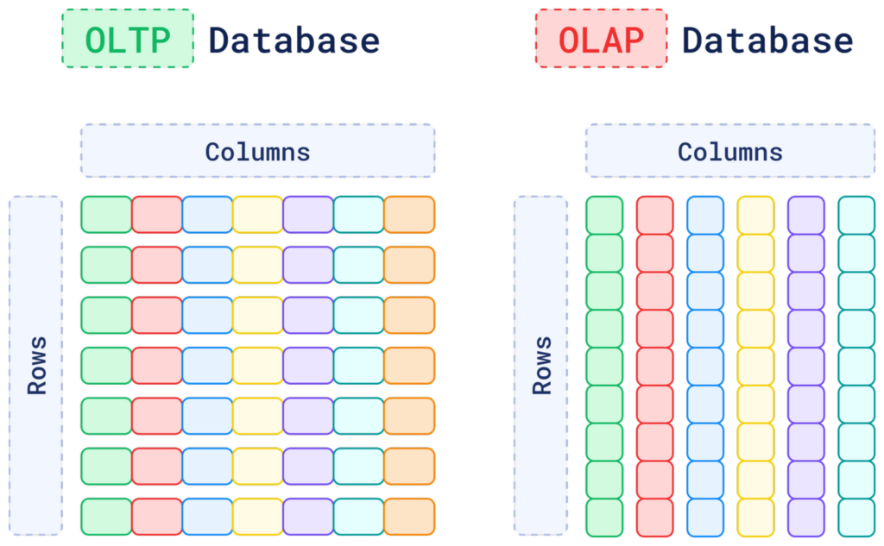
OLTP and OLAP Databases
Traditional OLTP and OLAP databases have been the backbone of data storage for decades.They are great at managing structured data with well-defined schemas, like name, address, phone number, and purchase history.

Slide 4
The Challenge with Traditional Databases
But when data can’t be easily categorized, like the content inside a PDF file, things start to get complicated.
You can always store the PDF file as raw data, perhaps with some metadata attached.
However, the database still wouldn’t be able to understand what’s inside the document, categorize it, or even search for the information that it contains.
Also, this applies to more than just PDF documents.
Think about the vast amounts of text, audio, and image data you generate every day.
If a database can’t grasp the meaning of this data, how can you search for or find relationships within the data?

Slide 5
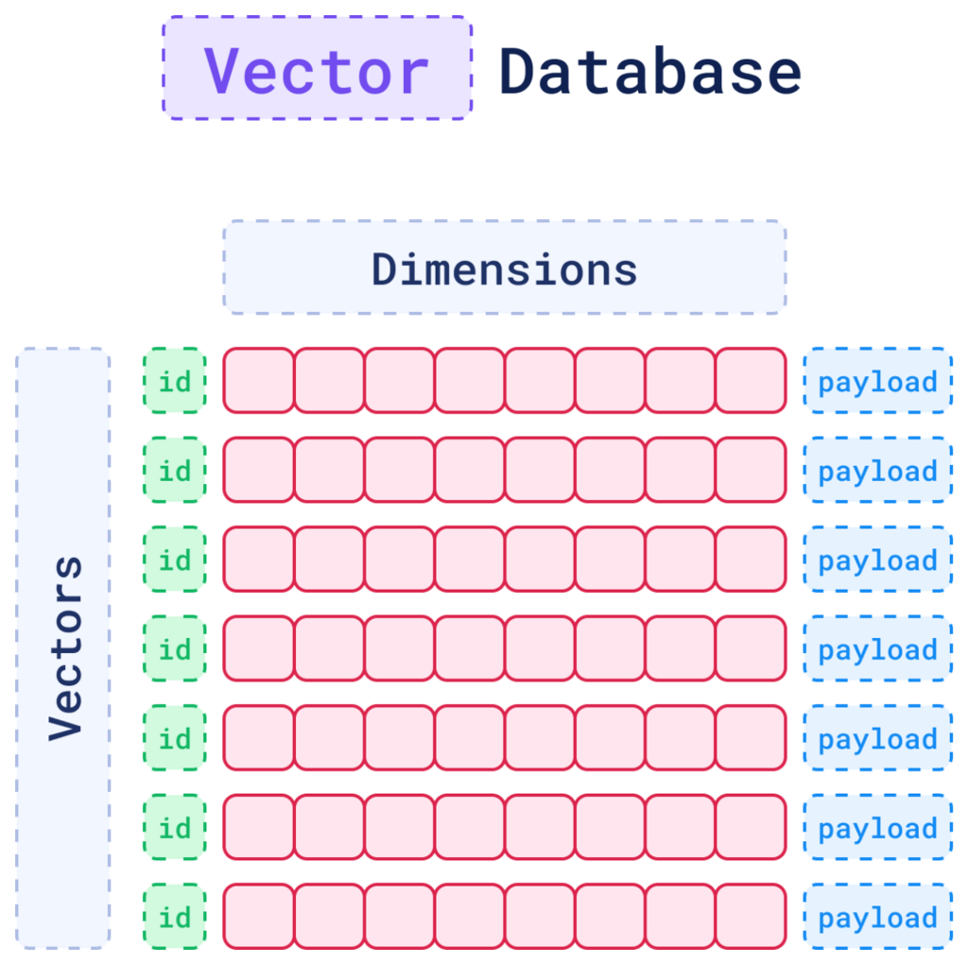
Vector databases
Vector databases allow you to understand the context or conceptual similarity of unstructured data by representing them as vectors, enabling advanced analysis and retrieval based on data similarity.

Slide 6
When to Use a Vector Database?
Feature | OLTP Database | OLAP Database | Vector Database
Data Structure | Rows and columns | Rows and columns | Vectors
Type of Data | Structured | Structured/Partially Unstructured | Unstructured
Query Method | SQL-based (Transactional Queries) | SQL-based (Aggregations, Analytical Queries) | Vector Search (Similarity-Based)
Storage Focus | Schema-based, optimized for updates | Schema-based, optimized for reads | Context and Semantics
Performance | Optimized for high-volume transactions | Optimized for complex analytical queries | Optimized for unstructured data retrieval
Use Cases | Inventory, order processing, CRM | Business intelligence, data warehousing | Similarity search, recommendations, RAG, anomaly detection, etc.

Slide 7
What is a Vector?
When a machine needs to process unstructured data - an image, a piece of text, or an audio file, it first has to translate that data into a format it can work with: vectors.
A vector is a numerical representation of data that can capture the context and semantics of data.
When you deal with unstructured data, traditional databases struggle to understand its meaning.
However, a vector can translate that data into something a machine can process
For example, a vector generated from text can represent relationships and meaning between words, making it possible for a machine to compare and understand their context.

Slide 8
Three key elements to define a vector
There are three key elements that define a vector in a vector database:
the ID
the dimensions
payload
Each one of these parts plays an important role in how vectors are stored, retrieved, and interpreted.
These components work together to represent a vector effectively within the system.
Together, they form a point, which is the core unit of data stored and retrieved in a vector database.

Slide 9
1. The ID: Your Vector’s Unique Identifier
Just like in a relational database, each vector in a vector database gets a unique ID.
Think of it as your vector’s name tag, a primary key that ensures the vector can be easily found later.
When a vector is added to the database, the ID is created automatically.
While the ID itself doesn’t play a part in the similarity search (which operates on the vector’s numerical data), it is essential for associating the vector with its corresponding “real-world” data, whether that’s a document, an image, or a sound file.
After a search is performed and similar vectors are found, their IDs are returned.
These can then be used to fetch additional details or metadata tied to the result.

Slide 10
2. The Dimensions: The Core Representation of the Data
At the core of every vector is a set of numbers, which together form a representation of the data in a multi-dimensional space.
These numbers are generated by embedding models, such as deep learning algorithms, and capture the essential patterns or relationships within the data.
That’s why the term embedding is often used interchangeably with vector when referring to the output of these models.

Slide 11
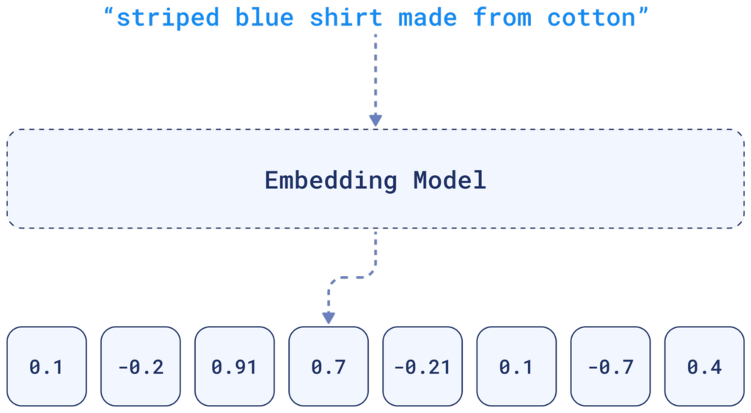
From Text to Vectors: How Does It Work?
To represent textual data, for example, an embedding will encapsulate the nuances of language, such as semantics and context within its dimensions.

Slide 12
Comparing two similar sentences
For that reason, when comparing two similar sentences, their embeddings will turn out to be very similar, because they have similar linguistic elements.
That’s the beauty of embeddings.
The complexity of the data is distilled into something that can be compared across a multi-dimensional space.

Slide 13
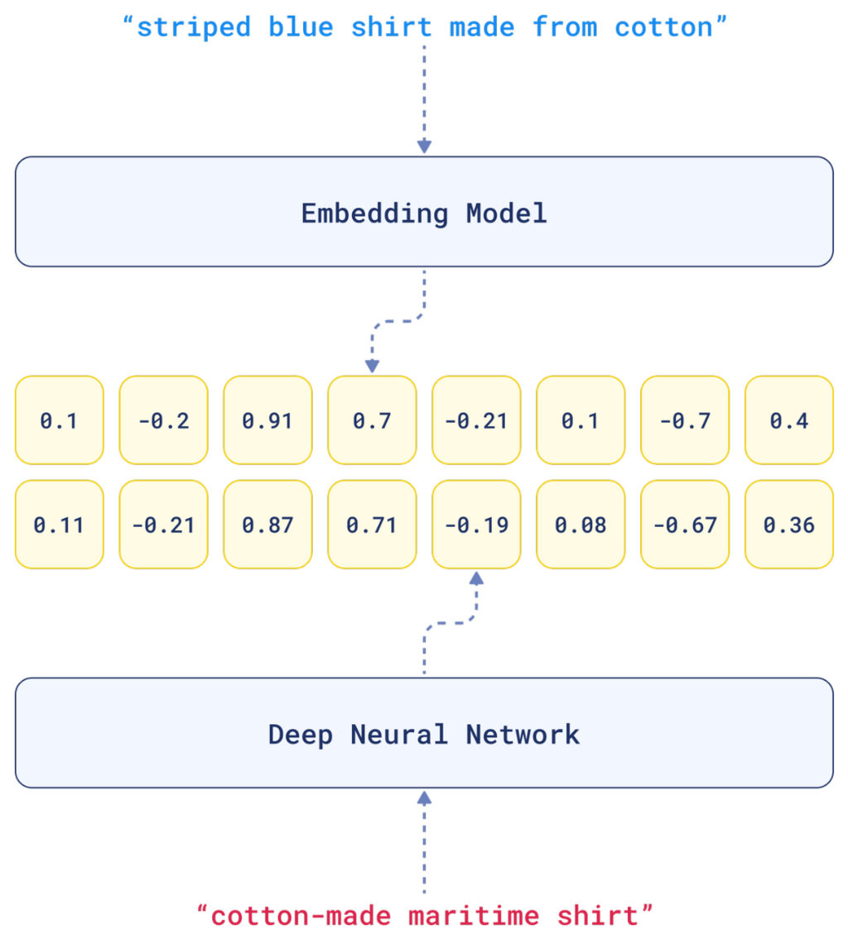

Slide 14
3. The Payload: Adding Context with Metadata
Sometimes you’re going to need more than just numbers to fully understand or refine a search.
While the dimensions capture the essence of the data, the payload holds metadata for structured information.
It could be textual data like descriptions, tags, categories, or it could be numerical values like dates or prices.
This extra information is vital when you want to filter or rank search results based on criteria that aren’t directly encoded in the vector.
This metadata is invaluable when you need to apply additional filters or sorting criteria.

Slide 15
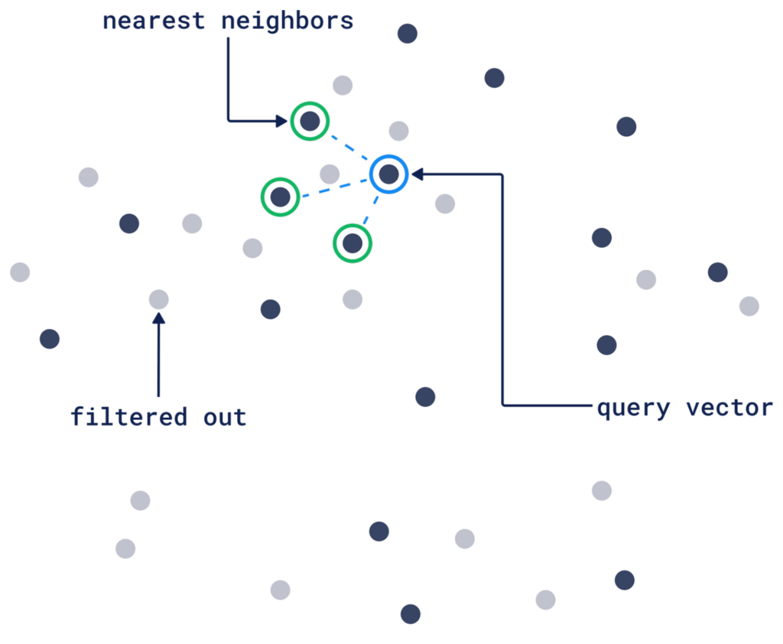
Example:
For example, if you’re searching for a picture of a dog, the vector helps the database find images that are visually similar.
But let’s say you want results showing only images taken within the last year, or those tagged with “vacation.”
The payload can help you narrow down those results by ignoring vectors that doesn’t match your query vector filtering criteria.

Slide 16
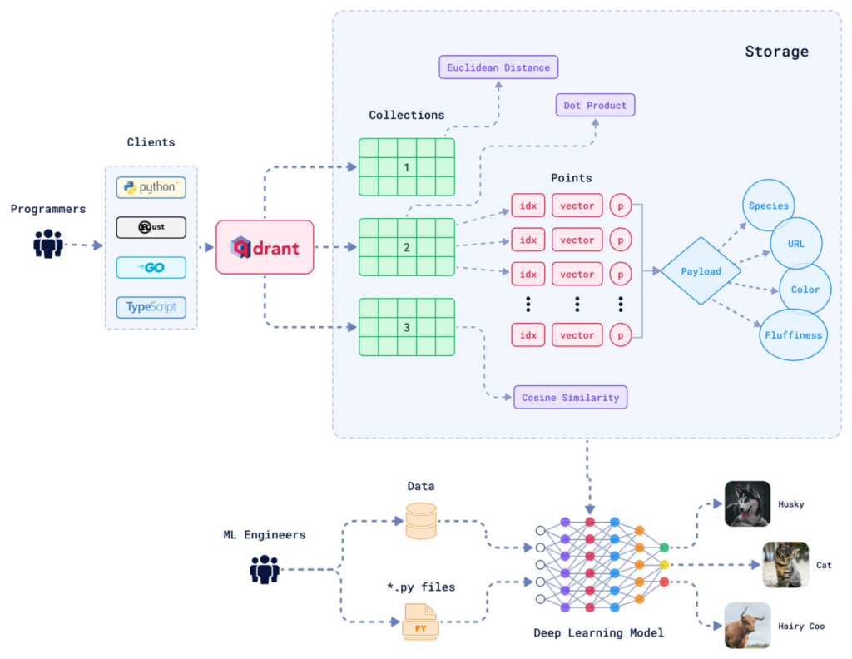
The Architecture of a Vector Database: Entities and Relations

Slide 17
Collections
A collection is essentially a group of vectors (or “points”) that are logically grouped together based on similarity or a specific task.
Every vector within a collection shares the same dimensionality and can be compared using a single metric.
Avoid creating multiple collections unless necessary; instead, consider techniques like sharding for scaling across nodes or multitenancy for handling different use cases within the same infrastructure.

Slide 18
Distance Metrics
These metrics defines how similarity between vectors is calculated.
The choice of distance metric is made when creating a collection and the right choice depends on the type of data you’re working with and how the vectors were created.

Slide 19
Here are the three most common distance metrics:
Euclidean Distance:
The straight-line path. It’s like measuring the physical distance between two points in space.
Pick this one when the actual distance (like spatial data) matters
Cosine Similarity:
This one is about the angle, not the length. It measures how two vectors point in the same direction, so it works well for text or documents when you care more about meaning than magnitude.
For example, if two things are similar, opposite, or unrelated.
Dot Product:
This looks at how much two vectors align.
It’s popular in recommendation systems where you’re interested in how much two things “agree” with each other

Slide 20
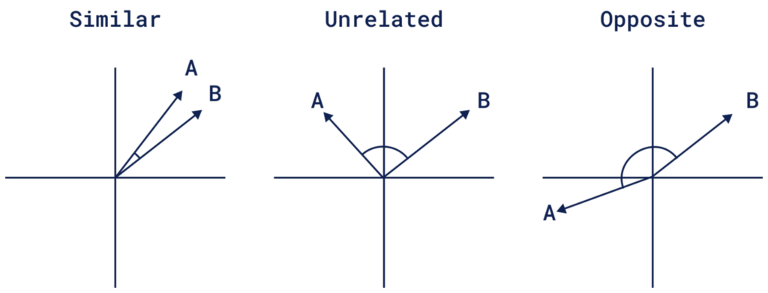

Slide 21
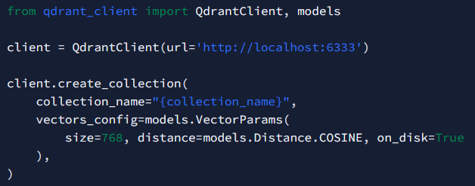
RAM-Based and Memmap Storage
By default, Qdrant stores vectors in RAM, delivering incredibly fast access for datasets that fit comfortably in memory.
But when your dataset exceeds RAM capacity, Qdrant offers Memmap as an alternative.
Memmap allows you to store vectors on disk, yet still access them efficiently by mapping the data directly into memory if you have enough RAM.
To enable it, you only need to set "on_disk": true when you are creating a collection

Slide 22
SDKs
Qdrant offers a range of SDKs.
You can use the programming language you’re most comfortable with, whether you’re coding in Python, Go, Rust, Javascript/Typescript, C# or Java.
https://github.com/qdrant/java-client

Slide 23
The Core Functionalities of Vector Databases
When you think of a traditional database, the operations are familiar: you create, read, update, and delete records.
These are the fundamentals. And guess what? In many ways, vector databases work the same way, but the operations are translated for the complexity of vectors.

